Slide 1


AWS IOT TO SEND TEXT MESSAGE NOTIFICATIONS
By
Hemamalini Madhanguru
Lakshmi Sundararajan
Natya Srinivasan
Pallavi Attimakula
Guided by
Dr.Nanda Ganesan

Slide 2
TABLE OF CONTENTS
Introduction
SNS
Lambda Function
AWS IoT

Slide 3
Objectives
The main aim of our project is to send text message notifications using AWS IoT
The purpose is to connect a physical device with AWS Iot , which sends notifications when an action occurs

Slide 4
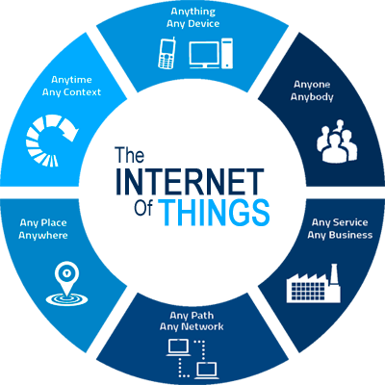
Internet of things
The Internet of things (IoT) is the inter-networking of physical devices embedded with electronics, software, sensors, actuators, and network connectivity that enable these objects to collect and exchange data.

Slide 5
Challenges in iot
There are certain challenges specific to IoT, and AWS takes care of these for you:
Device security: Each device identifies itself and authenticates to the cloud using a certificate. You use policies to control what devices have access to.
Service integration: You can link up to other AWS services like SNS (Simple Notification Service), SQS (Simple Queue Service), and LAMDA. IoT Rules can take you pretty far without writing code.
Two-way communication: Not only can devices send messages to the cloud, you can push state changes to a device — even if it’s offline at the moment.

Slide 6
Prerequisites
1) Amazon web services account
2) A mobile device to receive notifications

Slide 7
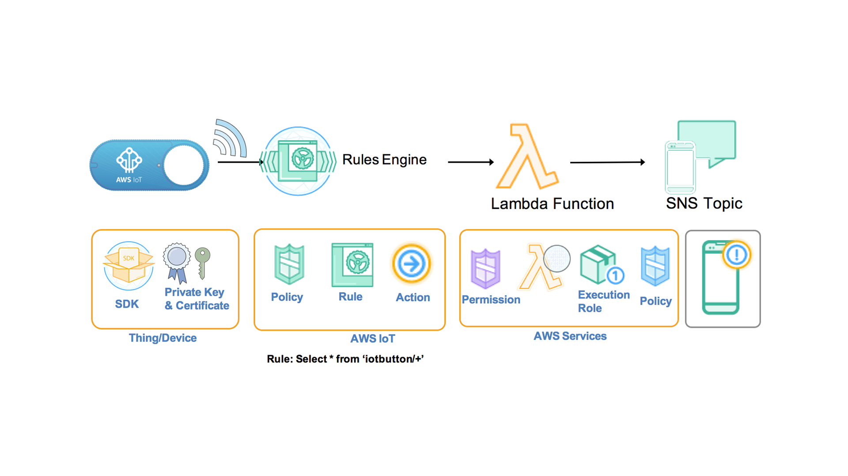
Workflow

Slide 8
Send a text message to your phone using SNS
Simple Notification Service (SNS) is a web service that enables applications, end-users, and devices to instantly send and receive notifications from the cloud
Sending text alerts is a practical use case for IoT
Configure SNS to send a text message to your phone Setup is quick, making SNS great for testing IoT Rules

Slide 9
Setting a topic
SNS uses something called a topic. A topic is a channel, kind of like the cable TV channel . The TV network broadcasts the latest episode of and only subscribers get to watch
Likewise, you can publish a message to a topic, and SNS pushes it out to subscribed users
Log into amazon web services and choose SNS which is a mobile service offered by AWS
Now create a topic by giving a topic name and a name for the display

Slide 10
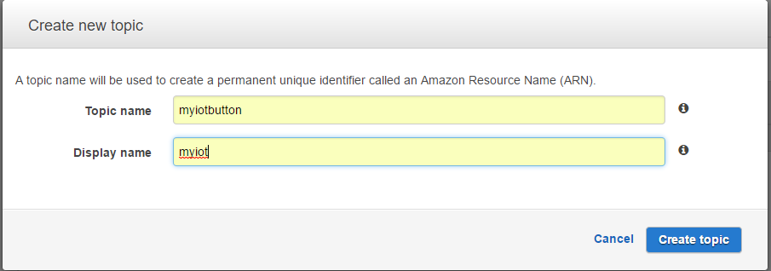
Setting a topic
The following dialog box appears.
The Display name shows up as a prefix in every message sent to the user

Slide 11
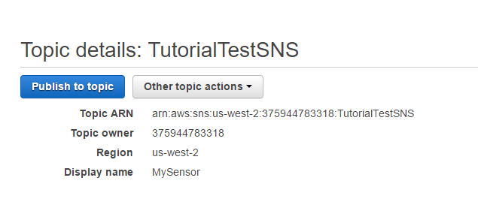
Setting up a topic
Once the topic is created , publish the topic.
The topic ARN is essential while using the lambda function for device connectivity

Slide 12
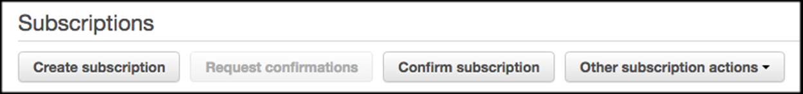
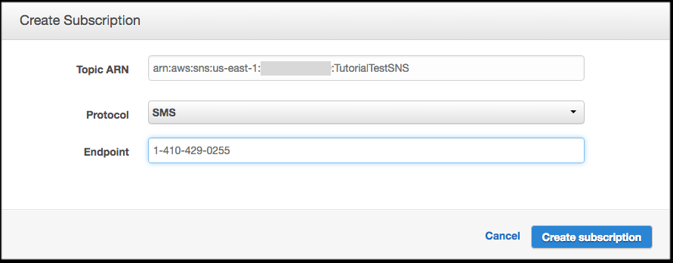
Create a subscription
On the Topic details page, click Create subscription.
In the Create Subscription modal, change the Protocol to SMS.
In the Endpoint field, type in your cell phone number.

Slide 13
Create a subscription
Click Create subscription.
This helps in creating the subscription.
You may receive a text message asking whether you would like to receive messages from MYSENSOR. Just follow the instructions (e.g. reply with YES MYSENSOR to confirm your subscription).
Now that your cell phone is subscribed to an SNS topic, you can start sending text messages.

Slide 14
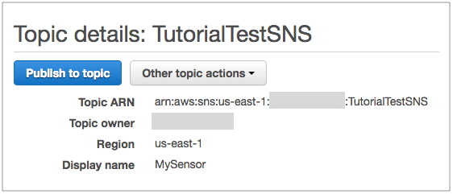
Send a Text Message
On the Topic details page, click Publish to topic.
On the Publish a message screen, type something into the Message field, like “your basement is flooded“.
(Note: The Subject field is used for email, so you can leave it blank.)
Click Publish message.

Slide 15
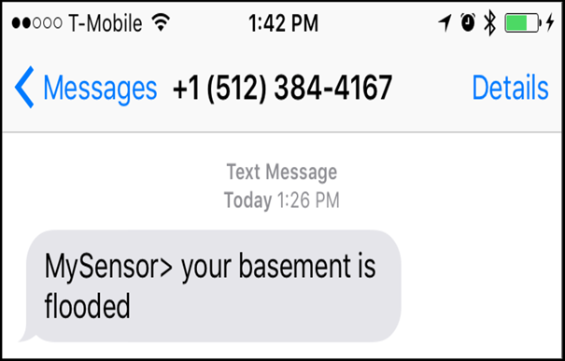
Send a Text Message
You should receive a text message.

Slide 16
AWS Lambda function
We will create a Lambda function that publishes a message to the Amazon SNS topic you created in the AWS IOT.
Choose an appropriate lambda function which is composed of functions triggered by events.
Configure the triggers with AWS IoT and enter the device serial number in order to configure the AWS IoT button.
The lambda function is invoked with the help of the code and the policies , certificates are given
The function is created

Slide 17
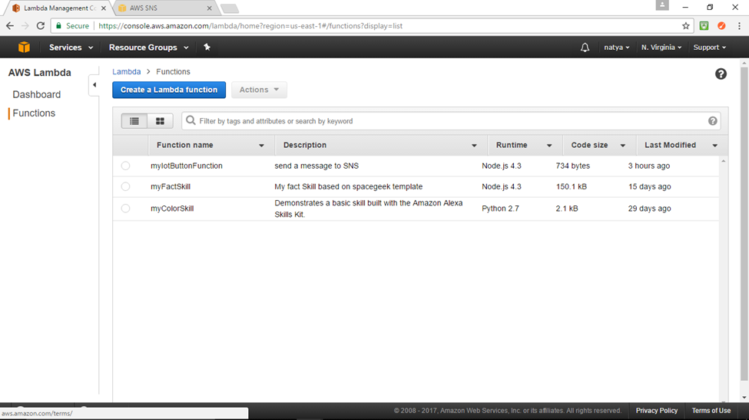
AWS Lambda function

Slide 18
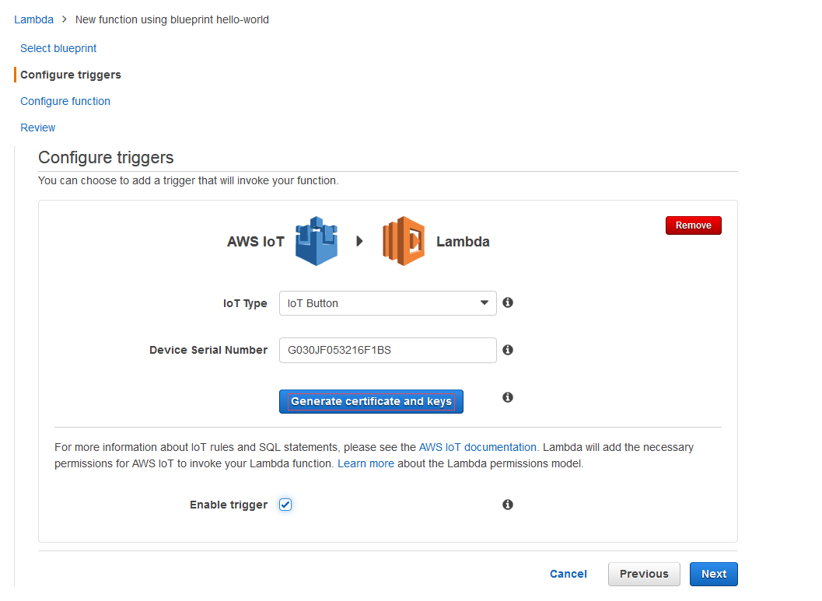
AWS Lambda function

Slide 19
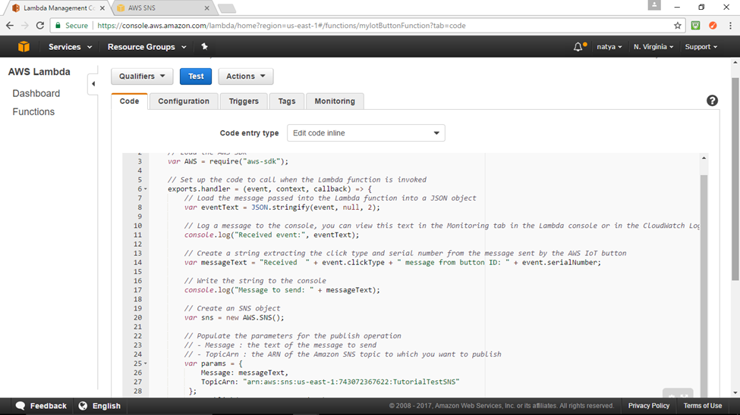
AWS Lambda function

Slide 20
Test the lambda function
Once the lambda function has been created, it has to be tested.
Therefore a Test event is configured and the json code is implemented.
A rule is created on AWS IoT console inorder to invoke the lambda function.
Configure an action(invoke a lambda function passing the message function) to the rule inorder to send the message. Now the rule is created.
Test the lambda rule by using MQTT client, which will further send a message to your mobile device.

Slide 21
AWS IOT
AWS IoT provides secure, bi-directional communication between Internet-connected things (such as sensors, actuators, embedded devices, or smart appliances) and the AWS cloud.
This enables you to collect data from multiple devices and store and analyze the data.

Slide 22
REGISTERING A THING
Devices connected to AWS IoT are represented by things in the thing registry. The thing registry allows you to keep a record of all the devices that are connected to your AWS IoT account
A thing is a representation of a specific device or logical entity. It can be a physical device or sensor (for example, a light bulb or a switch on a wall)
It can also be a logical entity like an instance of an application or physical entity that does not connect to AWS IoT but is related to other devices that do (for example, a car that has engine sensors or a control panel)

Slide 23
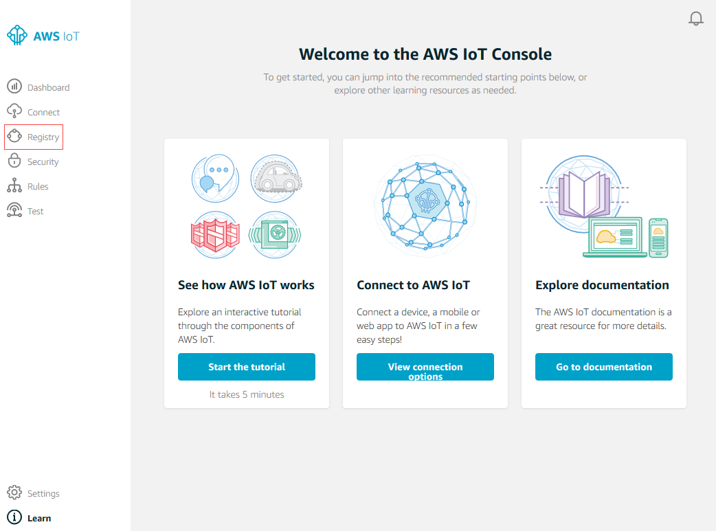
Registering a thing

Slide 24
Thing Registry
On the Welcome to the AWS IoT Console page, in the left navigation pane, choose Registry to expand the choices, and then choose Things.
On the page that says You don't have any things yet, choose Register a thing.
On the Register a thing page, in the Name field, type a name for your device. Choose Create thing to add your device to the thing registry.

Slide 25
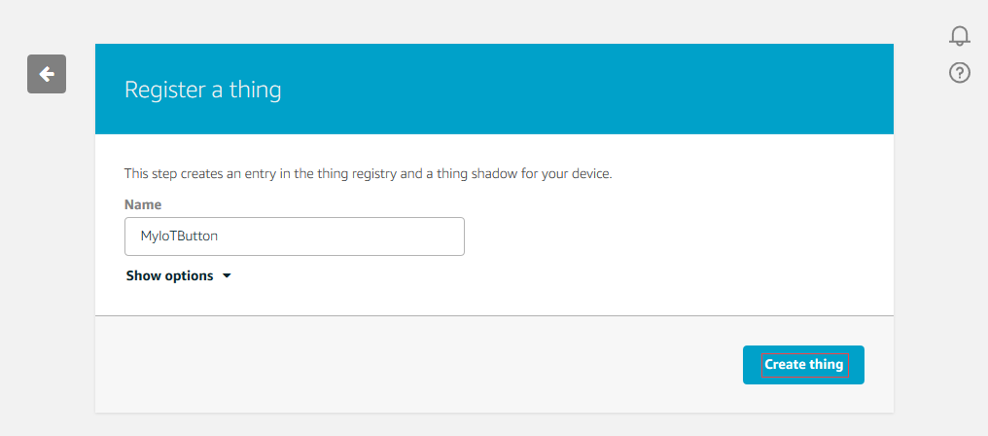
Entering the name for the thing

Slide 26
Create and Activate a Device Certificate
Communication between your device and AWS IoT is protected through the use of X.509 certificates. AWS IoT can generate a certificate for you or you can use your own X.509 certificate.
On the Details page, in the left navigation pane, choose Security.
On the Certificates page, choose Create certificate.
On the Certificate created page, choose Download for the certificate, private key, and the root CA for AWS IoT, save each of them to your computer, and then choose Activate to continue.

Slide 27
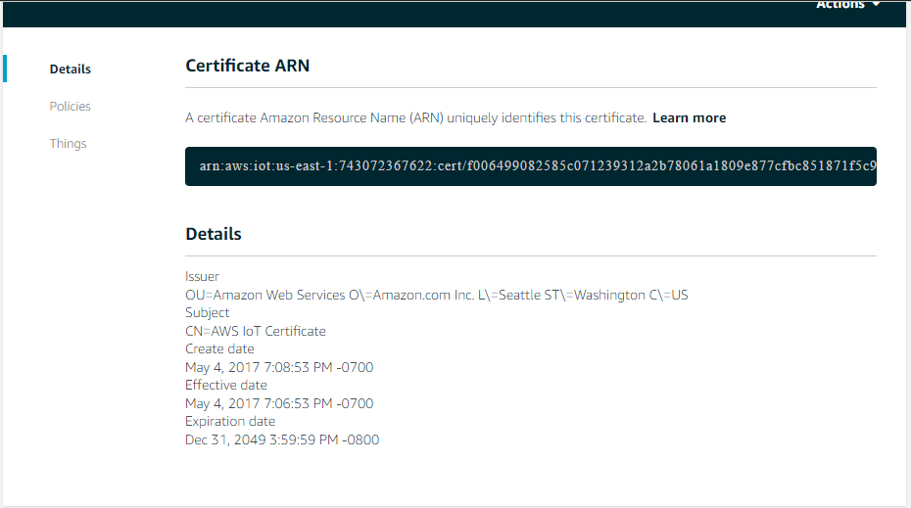
Creating device certificate

Slide 28
Attaching device policy
X.509 certificates are used to authenticate your device with AWS IoT. AWS IoT policies are used to authorize your device to perform AWS IoT operations, such as subscribing or publishing to MQTT topics. Your device will present its certificate when sending messages to AWS IoT. To allow your device to perform AWS IoT operations, you must create an AWS IoT policy and attach it to your device certificate.
On the Certificate created page, choose Attach a policy.
On the Add authorization to certificate page, choose Create new policy.

Slide 29
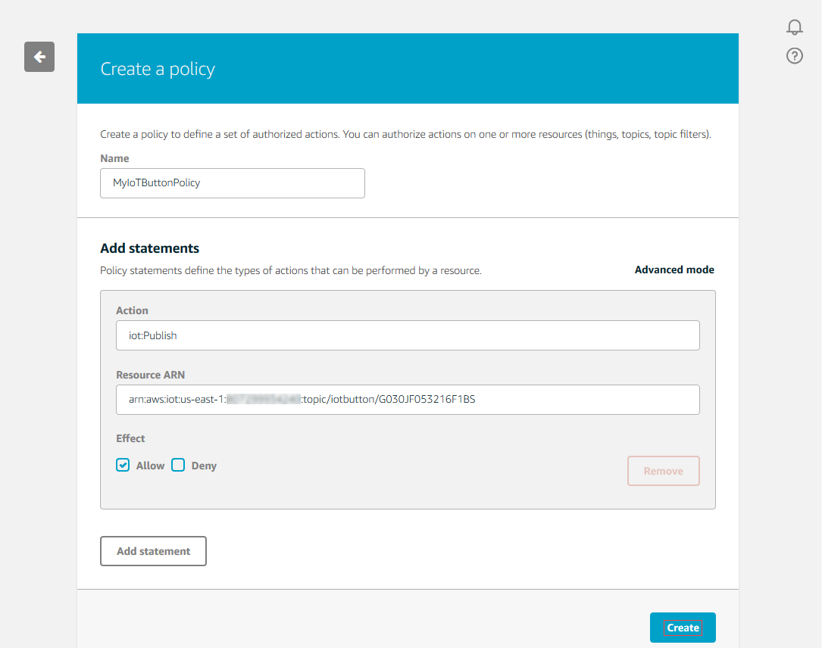
Attaching device policy

Slide 30
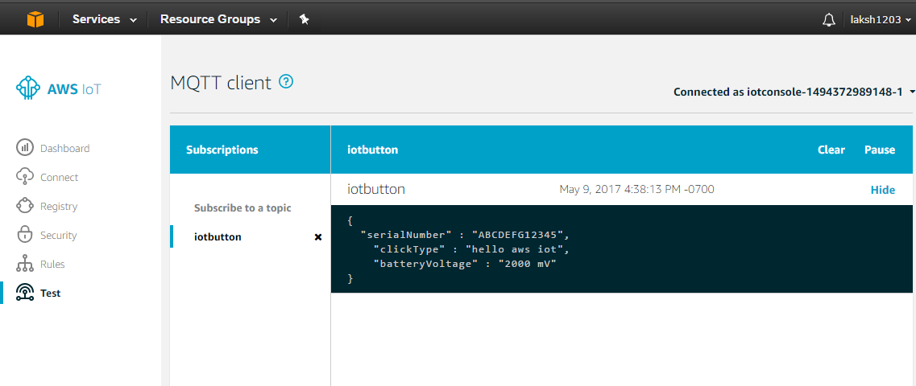
MQTTclient

Slide 31
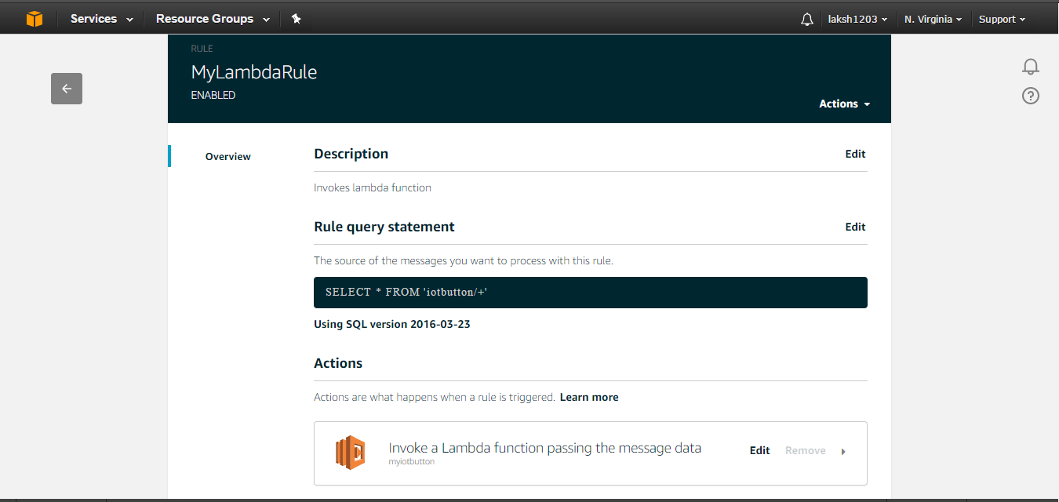
AWS IoT rule

Slide 32
Summary
From this project we get an overview of how to use aws iot, lambda and sns services.
This project serves as a beginners guide to explore more on aws services.

Slide 33
Limitations
No physical device to check for actual device notifications.
Also student aws account is limited to one module under each service

Slide 34
Web References
https://techcrunch.com/2015/10/08/amazon-announces-aws-iot-a-platform-for-building-managing-and-analyzing-the-internet-of-things/
https://aws.amazon.com/documentation/sns/
https://console.aws.amazon.com/iotv2/home?region=us-east-1#/rule/MyLambdaRule

Slide 35
Glossary
AWS Lambda runs your code on a high-availability compute infrastructure and performs all of the administration of the compute resources, including server and operating system maintenance, capacity provisioning and automatic scaling, code monitoring and logging

Slide 36
Question and Answer Session
The End

